Slide 1
Essential Questions
What is the significance of Mendel’s experiments to the study of genetics?
What is the law of segregation and the law of independent assortment?
What are the possible offspring from a cross using a Punnett square?
Mendelian Genetics
Copyright © McGraw-Hill Education

Slide 2
How Genetics Began
The passing of traits to the next generation is called inheritance, or heredity.
Heredity: the passing of physical characteristics from parents to offspring
Trait: a specific characteristic an organism can pass to its offspring through its genes.
Gregor Mendel (1800s) published his findings on the method of inheritance in garden pea plants:
Began the study of genetics, the science of heredity.
Cross-pollinated pea plants, which normally self-fertilize
Rigorously followed various traits in the pea plants he bred
Mendelian Genetics
Copyright © McGraw-Hill Education

Slide 3
The Inheritance of Traits
One trait Mendel noticed was seed color – some plants always produced green seeds, others always produced yellow seeds.
Mendel cross-bred the green and yellow seed plants.
Mendel called the green-seed and yellow-seed plants the parent, or P, generation.
Purebred parents are crossed
Mendelian Genetics
Copyright © McGraw-Hill Education

Slide 4
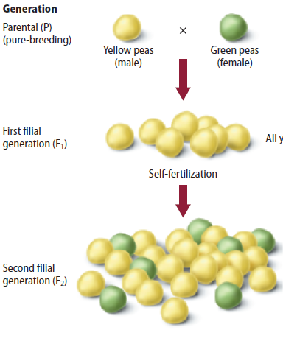
The Inheritance of Traits
F₁ and F₂ generations
The offspring of this P cross are called the first filial (F₁) generation.
The second filial (F₂) generation is the offspring from the F₁ cross.
In Mendel’s peas, the green-seed trait disappeared in the F₁ generation, but reappeared in the F₂ generation.
The F₂ generation showed a 3:1 ratio of yellow: green seeds
¾ tall and ¼ short
Mendelian Genetics
Copyright © McGraw-Hill Education

Slide 5
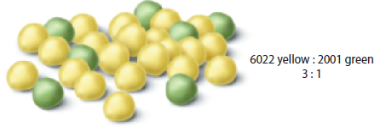
The Inheritance of Traits
F₁ and F₂ generations
Mendel studied seven different traits.
Seed or pea color
Flower color
Seed pod color
Seed shape or texture
Seed pod shape
Stem length
Flower position
In all cases, Mendel found the F₂ generation plants showed a 3:1 ratio of traits.
Mendelian Genetics
Copyright © McGraw-Hill Education

Slide 6
The Inheritance of Traits
Genes in Pairs
Mendel concluded that there must be two forms of the seed trait in the pea plants, and that each was controlled by a factor. (exist in pairs: female/male)
One factor can hide the other factor.
An allele is an alternative form of a single gene.
The gene for yellow seeds and the gene for green seeds are different alleles for the same gene.
Dominant alleles controlled the traits that appeared in the F₁ generation.
Recessive alleles were masked in the F₁ generation.
Mendelian Genetics
Copyright © McGraw-Hill Education

Slide 7
The Inheritance of Traits
Dominance
When modeling inheritance, the dominant allele is represented by a capital letter (Y), and a recessive allele is represented with a lower case letter (y).
An organism with two of the same alleles for a particular trait is homozygous for that trait (YY or yy).
An organism with two different alleles for a particular trait is heterozygous for that trait (Yy).
In heterozygous individuals, the dominant trait will be observed.
Mendelian Genetics
Copyright © McGraw-Hill Education

Slide 8
Dominant Allele | Capital Letter T
Recessive Allele | Lower case Letter t
Two dominant alleles | TT
Two recessive alleles | tt
Hybrid | Tt

Slide 9
The Inheritance of Traits
Genotype and phenotype
The appearance of an organism does not always indicate which pair of alleles it possesses.
An organism’s allele pairs are called its genotype.
The observable characteristic or outward expression of an allele pair is called the phenotype.
Mendelian Genetics
Copyright © McGraw-Hill Education

Slide 10
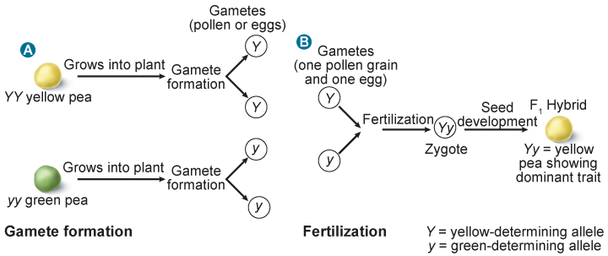
The Inheritance of Traits
Mendel’s law of segregation
The law of segregation states that the two alleles for each trait separate during meiosis.
During fertilization, two alleles for that trait unite.
Heterozygous organisms are called hybrids.
Mendelian Genetics
Copyright © McGraw-Hill Education

Slide 11
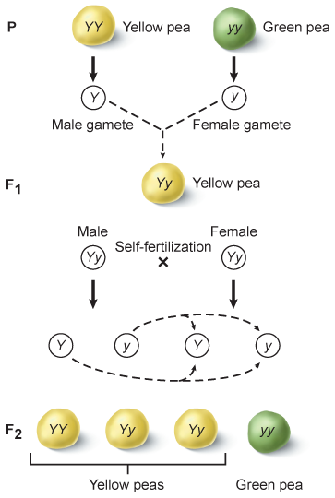
The Inheritance of Traits
Monohybrid cross
A cross that involves hybrids for a single trait is called a monohybrid cross.
Dihybrid cross
The simultaneous inheritance of two or more traits in the same plant is a dihybrid cross.
Mendelian Genetics
Copyright © McGraw-Hill Education

Slide 12
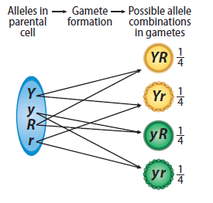
The Inheritance of Traits
Law of independent assortment
The law of independent assortment states that random distribution of alleles occurs during gamete formation.
Genes on separate chromosomes sort independently during meiosis.
Each allele combination is equally likely to occur.
Mendelian Genetics
Copyright © McGraw-Hill Education

Slide 13
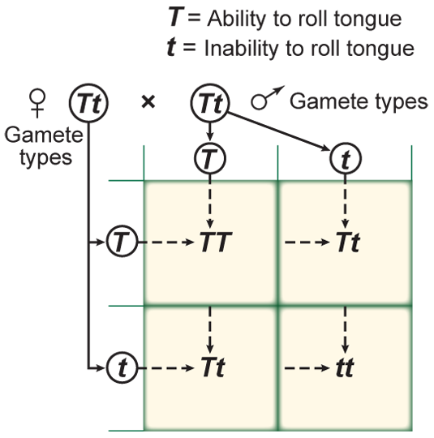
Punnett Squares
Punnett squares predict the possible offspring of a cross between two known genotypes.
Mendelian Genetics
Copyright © McGraw-Hill Education

Slide 14
Punnett Squares
Punnett square—monohybrid cross
The number of squares is determined by the number of different types of alleles produced by each parent.
Mendelian Genetics
Copyright © McGraw-Hill Education

Slide 15
Punnett Squares
Punnett square—dihybrid cross
Four types of alleles from the male gametes and four types of alleles from the female gametes can be produced.
Mendelian Genetics
Copyright © McGraw-Hill Education

Slide 16
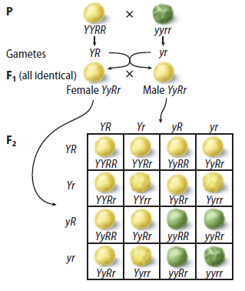
The resulting phenotypic ratio is 9:3:3:1.

Slide 17
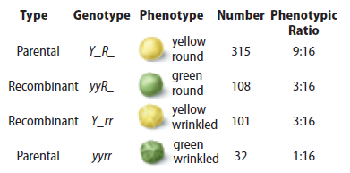
Probability
The inheritance of genes can be compared to the probability of flipping a coin.
Actual data might not perfectly match the predicted ratios.
Mendel’s results were not exactly a 9:3:3:1 ratio, but the larger the number of offspring involved, the more likely it will match the results predicted by Punnett squares.
Mendelian Genetics
Copyright © McGraw-Hill Education

Slide 18
Punnett Square Virtual Lab
Mendelian Genetics
Copyright © McGraw-Hill Education

Slide 19
Review
Essential Questions
What is the significance of Mendel’s experiments to the study of genetics?
What is the law of segregation and the law of independent assortment?
What are the possible offspring from a cross using a Punnett square?
Vocabulary
genetics
allele
dominant
recessive
homozygous
heterozygous
genotype
phenotype
law of segregation
hybrid
law of independent assortment
Mendelian Genetics
Copyright © McGraw-Hill Education

