Slide 1
Complex inheritance.

Slide 4
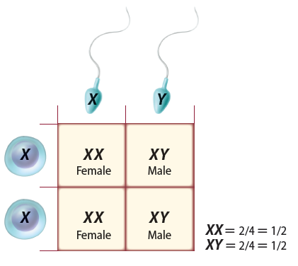
Sex Determination
One pair of chromosomes, sex chromosomes, determine an individual’s gender.
XX: female
XY: male
The other 22 pairs of chromosomes are called autosomes.
Complex Patterns of Inheritance
Copyright © McGraw-Hill Education

Slide 5
Dosage Compensation
The X chromosome carries a variety of genes that are necessary for the development of both females and males.
The Y chromosome mainly has genes that relate to the development of male characteristics.
In female, one X chromosome is inactivated in each cell.
Called dosage compensation or x-inactivation
Which X stops working in each cell is random.
Complex Patterns of Inheritance
Copyright © McGraw-Hill Education

Slide 6
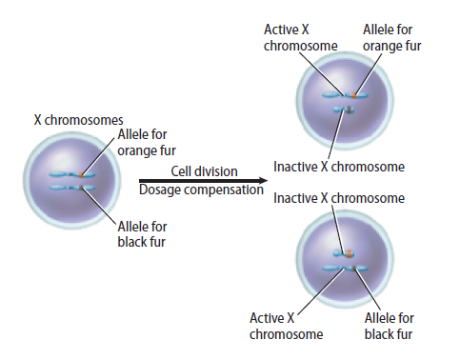
Dosage Compensation
Chromosome inactivation
Complex Patterns of Inheritance
Copyright © McGraw-Hill Education

Slide 7
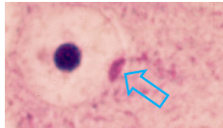
Dosage Compensation
Barr bodies
The inactivated X chromosome can be observed in cells.
Darkly stained, inactivated X chromosomes are called Barr bodies.
Complex Patterns of Inheritance
Copyright © McGraw-Hill Education

Slide 8
Inheritance patterns
Autosomal traits- Occur on normal, non sex chromosomes (Think Mendel’s genetics)
Can be Autosomal dominant
Or Autosomal Recessive

Slide 9
Sex-Linked Traits
Traits controlled by genes located on the X chromosome are sex-linked traits.
Because males have only one copy of the X chromosome, they are more affected by recessive X-linked traits.
Examples:
Colorblindness
Male pattern baldness
Hemophilia
Complex Patterns of Inheritance
Copyright © McGraw-Hill Education

Slide 10
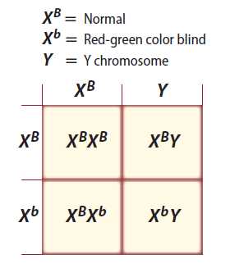
Sex-Linked Traits
Red-green color blindness
Recessive, X-linked trait
Mothers are carriers.
Complex Patterns of Inheritance
Copyright © McGraw-Hill Education

Slide 11
Color Blindness

Slide 13
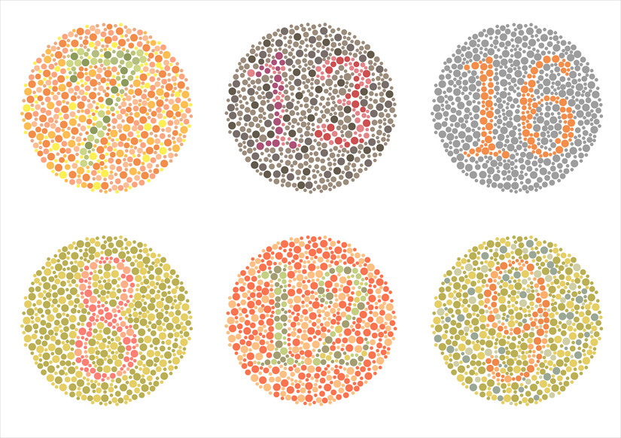

Slide 14
Color Blindness Video

Slide 15
Sex-Linked Traits
Male pattern baldness is found on the X chromosome. On a Jerry Springer show, a bald female talked about life without hair. Which of the following would be possible genetic reasons for her baldness?
Her Dad was normal, but her mom was bald
Both her dad and mom were normal, but mom was a carrier
Her Dad was a carrier and mom was normal
Her Dad was bald and her maternal grandfather was also bald
*** Draw a Punnett square for one of the above cases that you circled as being possible
Complex Patterns of Inheritance
Copyright © McGraw-Hill Education

Slide 16
Her Dad was bald and her maternal grandfather was also bald. Dad = X^{B}Y Grandfather = X^{B}Y; gave X^{B} to mom mom was then X X^{B} Offspring would then be:

Slide 17
Sex-Linked Traits
Hemophilia
Recessive, X-linked trait that causes delayed clotting of blood
BLEEDER’s DISEASE
Normal blood clots in 2-8 minutes
Hemophilia take up to 30 minutes
Complex Patterns of Inheritance
Copyright © McGraw-Hill Education

Slide 18
Hemophilia

Slide 19
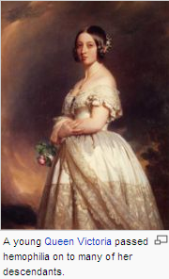
Hemophilia

Slide 21
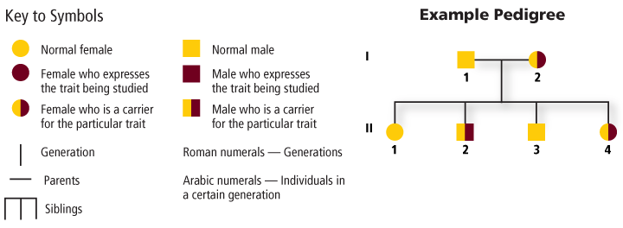
Pedigrees
A pedigree is a diagram that traces the inheritance of a particular trait through several generations.
Basic Patterns of Human Inheritance
Copyright © McGraw-Hill Education

Slide 25
Analyzing Pedigrees
Inferring Genotypes
Knowing physical traits can determine what genes an individual is most likely to have.
Predicting Disorders
Record keeping helps scientists use pedigree analysis to study inheritance patterns, determine phenotypes, and ascertain genotypes.
Basic Patterns of Human Inheritance
Copyright © McGraw-Hill Education

Slide 26
Karyotype Studies
Scientists study not only genes but entire chromosomes.
Images of chromosomes stained during metaphase allow scientists to study sister chromatids and homologous chromosomes.
Karyotype – micrograph in which the pairs of homologous chromosomes are arranged in decreasing size.
Chromosomes and Human Heredity
Copyright © McGraw-Hill Education

