Slide 2
Chapter 2 - Motion

Slide 3
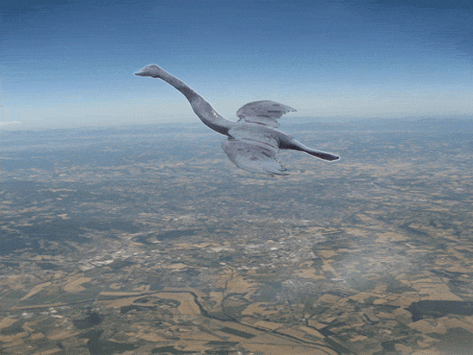
Describing Motion
Section 1

Slide 4
List some things that are not in Motion
How do you know if something is or isn’t in motion?
How do you describe motion?
What are some words we use to describe motion?
MOTION – an object changes its position
relative to a reference point
Motion depends on the reference point you’re
describing it from
https://www.youtube.com/watch?v=9yKuy2DdSOs – 30 sec. Motion with Reference Point: Moving Sidewalk demo
https://www.youtube.com/watch?v=MjZI9mRELFM – 2.47 min. (Visuals only) Introduction to Relative Motion using a Quadcopter Drone

Slide 5
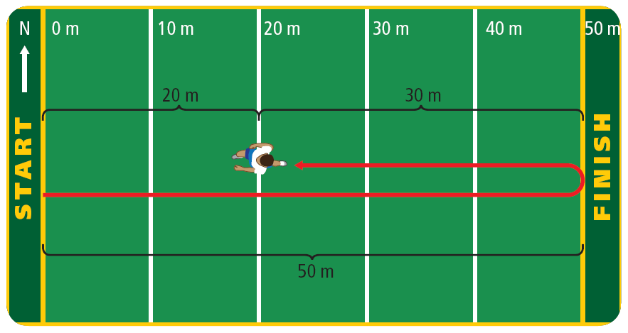
Has anyone snuck out of the house? How?
If you snuck out you probably took advantage of the difference between distance and displacement.
Often it is helpful to describe motion by position
Distance – how far something moves (SI unit = meter)
What distance has the figure moved?

Slide 6
Displacement – distance and direction an object moves from its starting position
How is displacement different from distance?
What is the runner’s displacement?

Slide 7
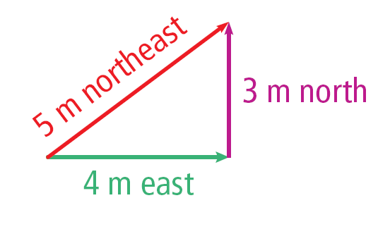
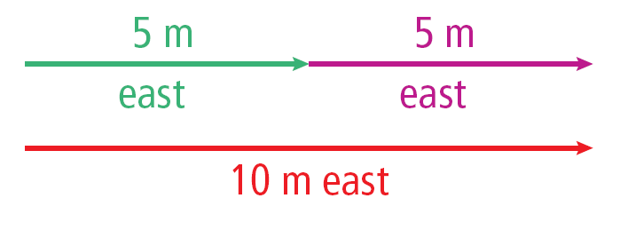
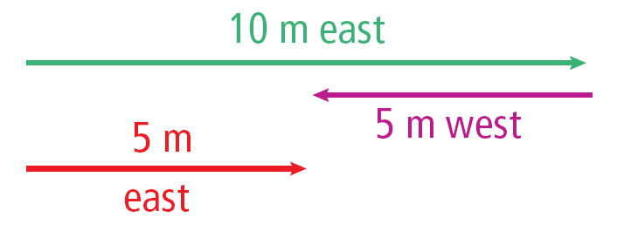
Displacement & Distance - scenario
The green and purple lines are representing a person’s travel. In each scenario, what is the distance and displacement of the person?
Distance = 7 m
Displacement = 5 m NE
When distances are not in the opposite or the same direction, you can’t +/- the distances to get displacement (estimate)
Distance = 10 m
Displacement = 10 m east
When distances are in the same direction, add the distances to get displacement
Distance = 15 m
Displacement = 5 m east
When distances are in the opposite direction, subtract the distances to get displacement

Slide 8
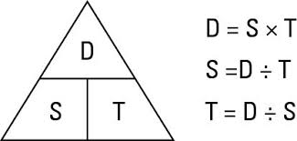
SPEED
What is it?
Speed is distance per unit time

Slide 9
Example practice problems
3. How far does a car travel in .75 h if it is moving 88 km/h?
1. A passenger elevator travels from the 1st to the 60th floor, a distance of 210 m, in 35 s. What is the elevator’s speed?
S = 40 km/h
D = 10 km
t = D/S
10/40 = .25 h or 15 min.
t = .75 h
S = 88
km/h
D = S x t
.75 x 88 = 66 km
D = 210 m
T = 35 s
S = D/t
210/35 = 6 m/s
2. A motorcycle is moving at 40 km/h. How long does it take to travel a distance of 10 km?
Solve

Slide 10
There is more than one way to describe Speed.
Think about a trip you’ve taken to Sioux Falls or somewhere else lately.
Are you going the same speed the whole time?

Slide 11
The Different Terms for describing speed
Average Speed – is calculated when speed changes throughout a trip – like normal driving when you are speeding up and slowing down regularly
Avg. Speed = Total Distance ÷ Total time
Instantaneous Speed – how fast an object is traveling at one instant in time
Constant speed – not going faster or slower, remaining at the same speed; like when you set the cruise control on your car

Slide 12
This is a Distance-time Graph – describe the motion of the object

Slide 13
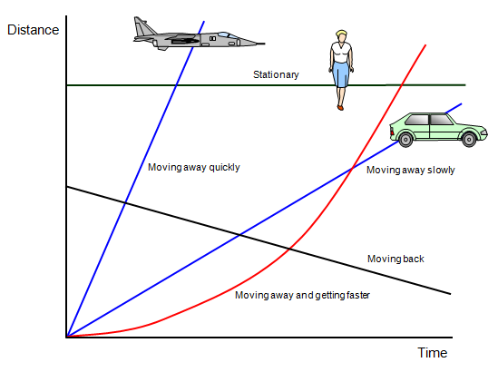
Here’s another – Describe the motion of the object

