Slide 1
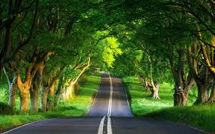
Can you think of any aspect of life that does not use measurement?

Slide 2
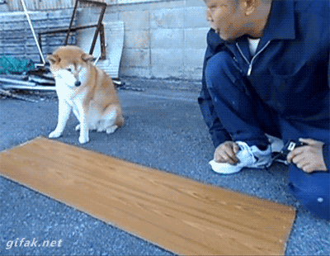
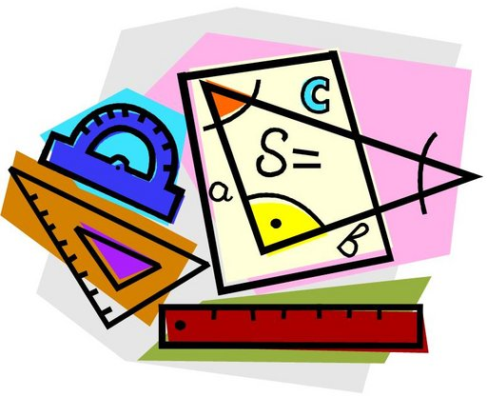
Chapter 1 – The Nature of Science
Section 2: Standards of Measurement

Slide 3
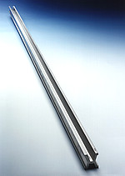
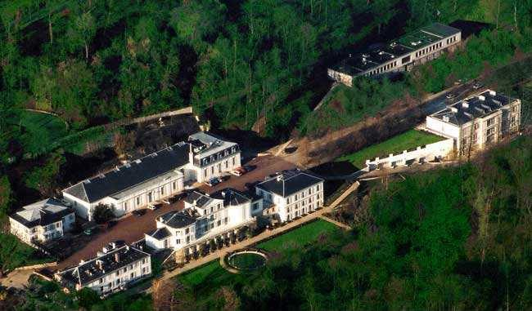
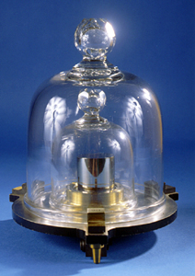
IN order to measure anything…
There needs to be a standard
A STANDARD is an exact quantity that people agree to use to compare measurements
National prototype kilogram K20, one of two prototypes stored at the US National Institute of Standards and Technology in Gaithersburg, Maryland
International Bureau of Weights and Measures in‎ Sèvres, France

Slide 4
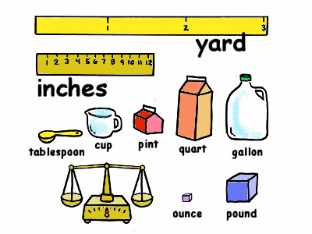
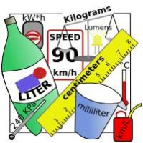
Two systems
Metric
English
Examples:
Length – feet, yards, miles
Volume – gallons, cups, quarts, cubic feet/inches
Temperature - degrees Fahrenheit or Celsius
Weight – pounds, ounces
Time – seconds, minutes, hours
What makes this system difficult?
Converting between units
Examples: (SI units underlined)
Length – meters (milli, centi, kilo)
Volume – liters (milli, kilo)
Temperature – Kelvin (not indicated by degrees)
Mass – grams/kilograms (milli, kilo)
Time – seconds, minutes, hours
What makes this a better system?
Converting between units is simple, because it is in
MULTIPLES of 10
SI Units – International System

Slide 5
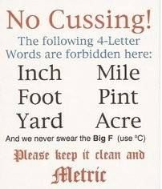

Slide 6
What makes converting so easy in the metric System?
USING PREFIXES that represent the size of the unit (multiples of 10)
So we simply move the decimal right or left depending on what we are starting with and where we are going to
Move it right if you are converting from a large unit to a smaller unit (the number will get larger)
Move it left if you are converting from small unit to a larger unit (the number will get smaller)
This is accomplished by dividing or multiplying by 10

Slide 7
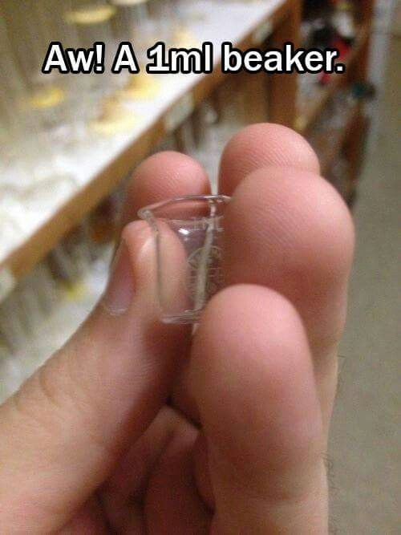
JUST BECAUSE…
It’s soooooo cute
1 ml (liquid) = 1 cm³ (solid)

Slide 9
Convert 3.2 Liters (L) to milliliters (mL)
Answer – 3200 milliliters (mL)
Convert 5380 milligrams (mg) to grams (g)
Answer - 5.38 grams (g)
Convert 2.32 kilometers (km)to centimeters (cm)
Answer – 232,000 cm
EXAMPLES: Practice converting

Slide 10
Just To make sure:
Matter is…
Anything that has mass and takes up space
Volume is…
Amount of space occupied by an object
Mass is…
The quantity of matter in an object
https://www.youtube.com/watch?v=JjCaRS-CABk

Slide 11
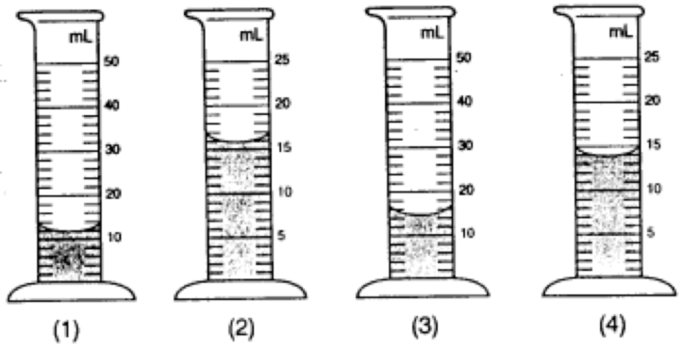
What volume is each Graduated cylinder holding?
12 mL
16 mL
14 mL
14 mL

Slide 12
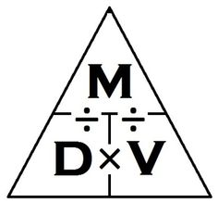
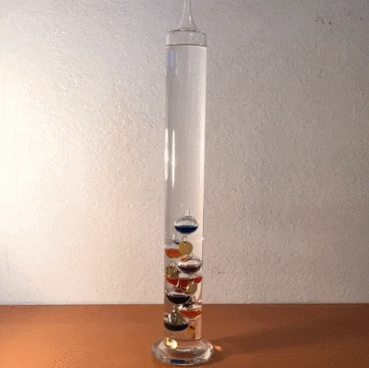
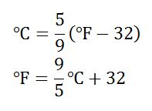
More Measurements
Density
Temperature
Definition – mass per unit volume
By looking at the definition, what do you suppose the formula to calculate density is?
Mass ÷ volume = Density
When a unit has more than one unit, it is called a derived unit (derived from two or more other units)
Example – What is the density of a wood block that’s mass is 500g and it takes up 2.5 Liters of space?
500 ÷ 2.5 = 200 g/L
Kelvin is the SI unit of temperature
There are no degrees when using Kelvin
Convert body temperature to °Celsius, then to Kelvin.
5/9 *(98.6 °F – 32) =37 °C
37 °C + 273 = 310 K

Slide 13
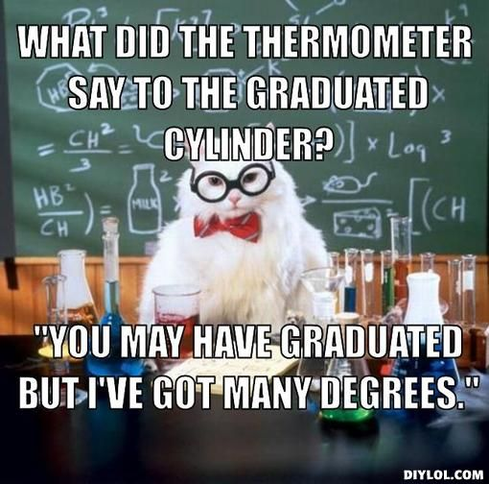
And now… since you know everything there is to know about volume and temperature… a joke

